Slide 1
Descriptive statistics and data visualization
Lecture 02
EAS 42000/A4200
Fall 2025
Prof. Spencer Hill

Slide 2
What we’re covering:
Descriptive statistics: what are they, why do we need them?
Measures of central tendency
Measures of variation

Slide 3
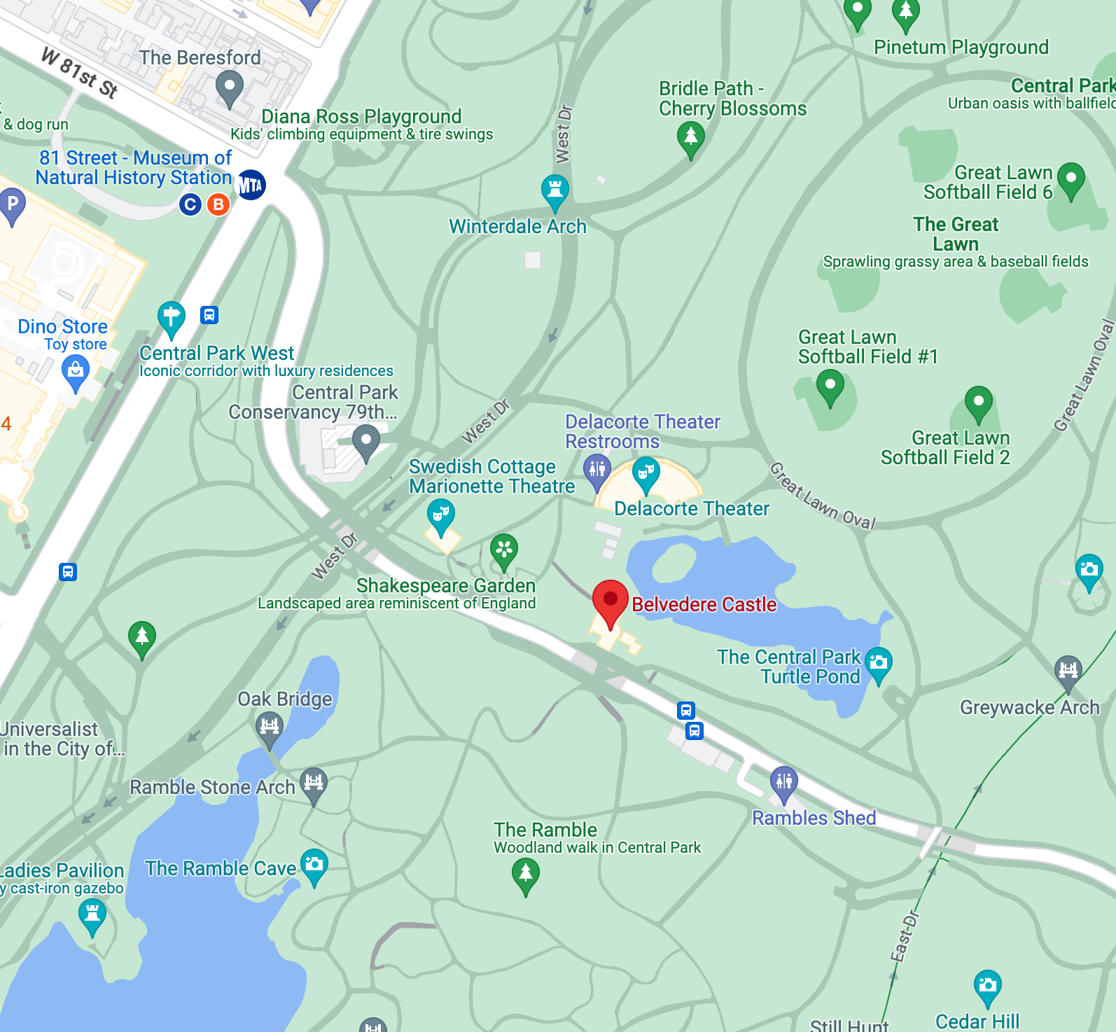
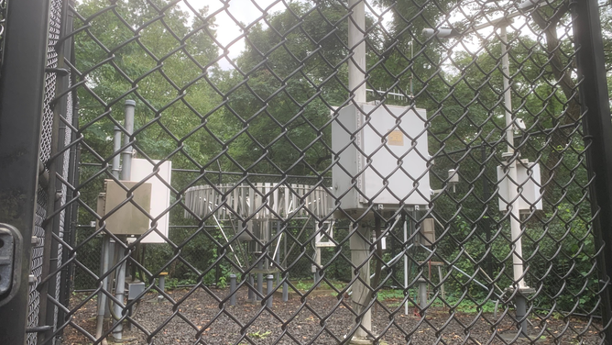

Recall: we’ll use a dataset of daily weather data from a station in Central Park
https://www.foxweather.com/weather-news/new-york-city-arguably-has-the-most-unique-weather-observations-in-america

Slide 4
What are descriptive statistics?
What does the phrase descriptive statistics bring to your mind?
A useful definition: “brief informational coefficients that summarize a given data set”
https://www.investopedia.com/terms/d/descriptive_statistics.asp

Slide 5
What we’re covering:
Descriptive statistics: what are they, why do we need them?
Measures of central tendency
Measures of variation

Slide 6
In words, what do you think a “measure of central tendency” would be?
Answer: what “typical” values of the dataset look like
Boiled down to a single number
But there are different useful meanings of “typical,” and so there are multiple useful measures of central tendency
Are there any that come to your mind?

Slide 7
The mean: .

Slide 8
The mean (a.k.a. average): sum up all values, divide by the total number of values
Symbolically:
where
overbar: mean
X_i: the dataset
subscript i: index of individual values
N: total number of values
Sigma: sum over all values from 1 to N (“summation notation”)

Slide 9
The mean (a.k.a. average): sum up all values, divide by the total number of values
Conceptually: the value such that if every point equaled that value, the sum over all points remained the same
Arguably the most widely used central tendency measure
Extensions/variations: geometric mean; weighted mean
Weighted comes up often in climate: lat-lon gridded data, have to weight by surface area of each gridbox

Slide 10
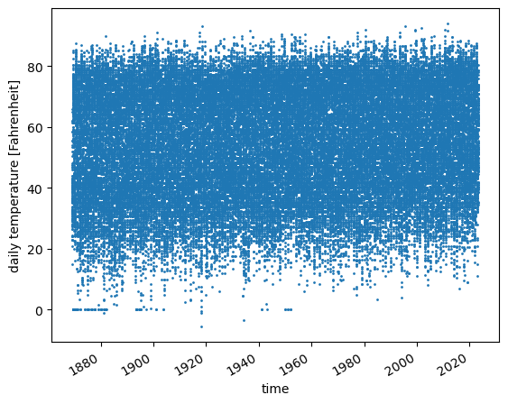
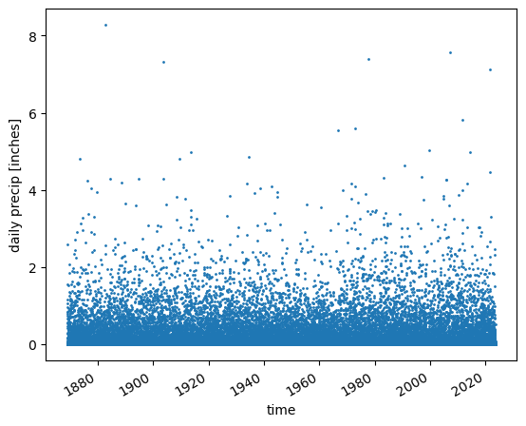
The mean (a.k.a. average): sum up all values, divide by the total number of values
Looking at the temperature and precip timeseries again, what are your guesses for each one’s mean?

Slide 11
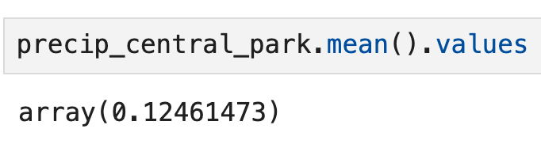
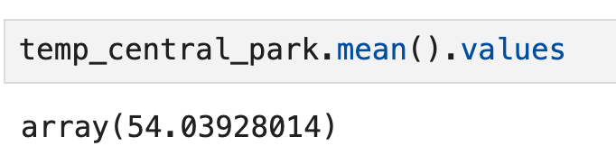
The mean (a.k.a. average): sum up all values, divide by the total number of values

Slide 12
The median: .

Slide 13
The median: sort points in ascending or descending order, then split into two halves
In other words, the value such that half of the points are larger, and half the points are smaller
Q: is there always a point in the dataset equal to the median?
A: Yes if N is odd; not always if N is even.
Compared to the mean, robust to outliers

Slide 14
The median: sort points in ascending or descending order, then split into two halves
It is a particular case of a more general quantity, percentiles
The Nth percentile is the value such that N% of values lie below it and (100-N)% lie above it
Or if written as fraction (0 to 1) instead of percent: quantiles
But for central tendency, median is the right choice

Slide 15
The median: sort points in ascending or descending order, then split into two halves
Looking at the temperature and precip timeseries again, what are your guesses for each one’s median?

Slide 16
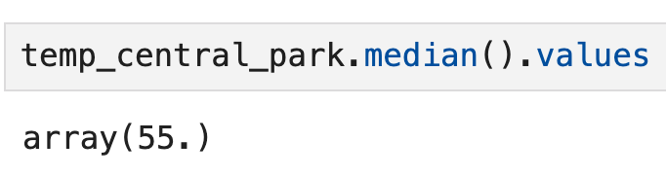
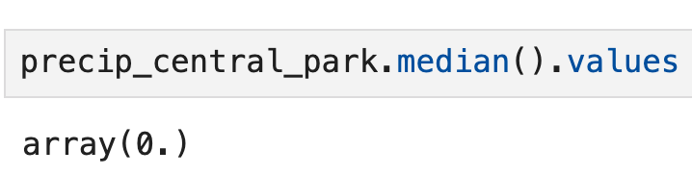
The median: sort points in ascending or descending order, then split into two halves

Slide 17
The mode: .

Slide 18
The mode: the value that occurs most frequently in the dataset
So in a sense, it’s the most literal sense of a “typical” value: the one that occurs most often
If there’s a tie: all of them are the mode; the mode is multi-valued

Slide 19
The mode: the value that occurs most frequently in the dataset
Q: For our temperature data (ignoring the spurious “0” values we discussed), do you expect there to be a single mode?
A: It depends on the precision of the measurement!
For a continuous, unbounded quantity like temperature (assuming we’re far from absolute zero!), the actual daily average will never repeat.
But all measurements have finite precision!

Slide 20
The mode: the value that occurs most frequently in the dataset
Looking at the temperature and precip timeseries again, what are your guesses for each one’s mode?

Slide 21
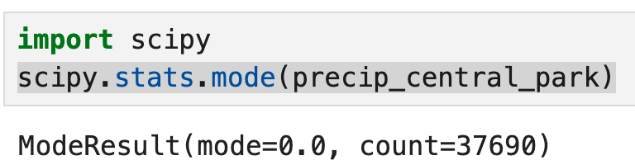
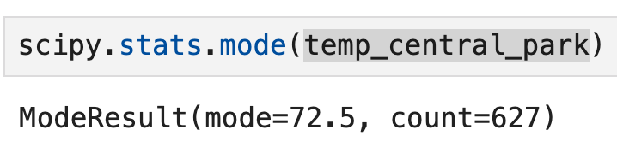
The mode: the value that occurs most frequently in the dataset

Slide 22
Different measures of central tendency can have similar or very different values
Measure | Precipitation [inches] | Temperature [°F]
Mean | 0.1246… | 54.0392…
Median | 0 | 55.0
Mode | 0 | 72.5
BUT for temperature, these values come with a caveat,
because of the spurious points we found!
These calculations include them along with all the others.

Slide 23
What we’re covering today:
Measures of dispersion
range, variance, standard deviation, coefficient of variation
Measures of shape

Slide 24
The range: .

Slide 25
The range: difference between the largest and smallest values
Symbolically:
Conceptually: the total “width” of the dataset
Just how different can two values be?

Slide 26
The range: difference between the largest and smallest values
Looking at the temperature and precip timeseries again, what are your guesses for each one’s range?

Slide 27
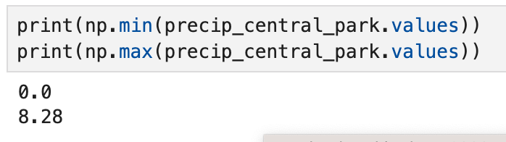
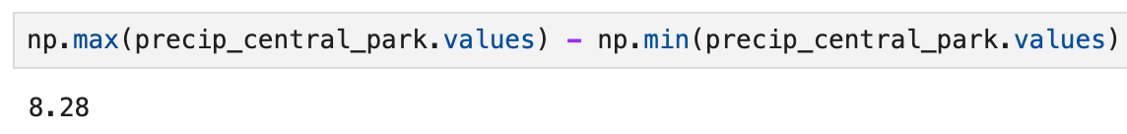
The range: difference between the largest and smallest values

Slide 28
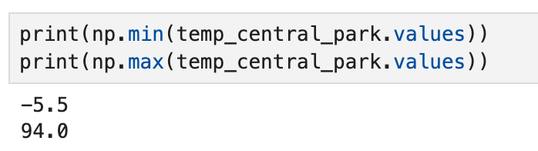
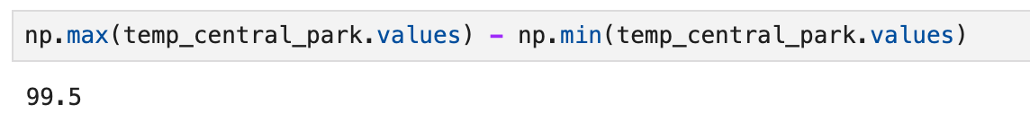
The range: difference between the largest and smallest values

Slide 29
The interquartile range: difference between the 25th and 75th percentile values
Quartiles: split dataset into four “bins”: 0th to 25th percentile, 25th-median, median-75th, 75th-100th
Quartile = 4 even bins; quintile = 5 bins; decile 10 bins; etc.
Interquartile range (or “IQR”): difference between 75th and 25th
Much less sensitive to outliers than full range

Slide 30
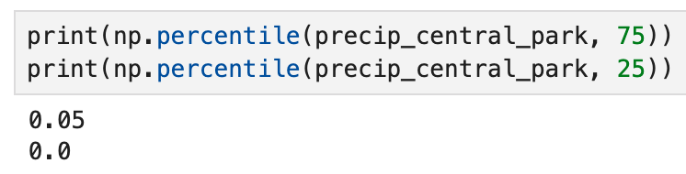
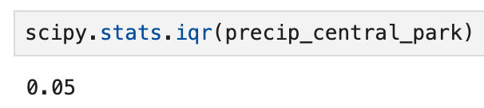
The interquartile range: difference between the 25th and 75th percentile values

Slide 31
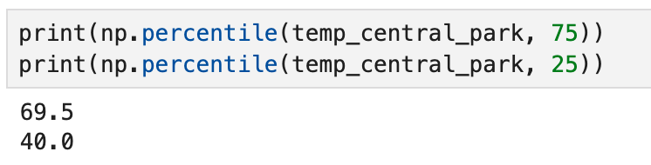
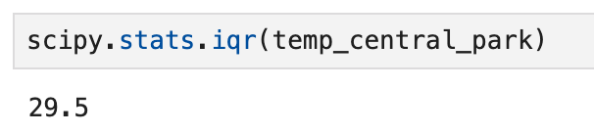
The interquartile range: difference between the 25th and 75th percentile values

Slide 32
The variance: .

Slide 33
The variance: average of square of differences from the mean
Symbolically:
where
overbar: mean
X_i: the dataset
subscript i: index of individual values
N: total number of values
Sigma: sum over all values from 1 to N (“summation notation”)

Slide 34
The variance: average of square of differences from the mean
Q: What are the units of var(X)?
A: The square of the units of X (e.g. inches² for precip)
Q: What’s the smallest possible value of variance?
A: Zero. If all values are identical. Can’t be negative!

Slide 35
The variance: average of square of differences from the mean
Looking at the temperature and precip timeseries again, what are your guesses for each one’s variance?

Slide 36
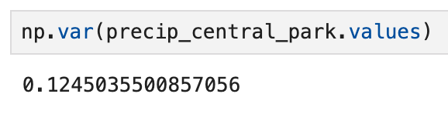
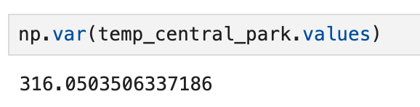
The variance: average of square of differences from the mean
Q: What’s a reasonable level of precision (i.e. number of decimal points to include) for reporting these quantities?
A: Precip reported to nearest 0.01 inch; temperature to nearest 0.5 deg F, so no more than that: 0.12 and 316.0

Slide 37
The standard deviation: .

Slide 38
The standard deviation: the square root of the variance
Symbolically:
As such, variance is often written as

Slide 39
The standard deviation: the square root of the variance
Q: What are the units of stdev(X)?
A: The same as the units of X (e.g. inches for precip)
Q: What’s the smallest possible value of the standard deviation?
A: Zero. If all values are identical. Can’t be negative!

Slide 40
The standard deviation: the square root of the variance
Looking at the temperature and precip timeseries again, what are your guesses for each one’s standard deviation?

Slide 41
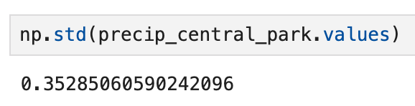
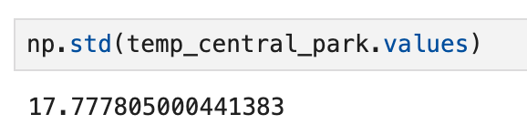
The standard deviation: the square root of the variance
Trick Q: Which quantity, temperature or precip, has a “larger” standard deviation?
A: They can’t be compared! They have different dimensions, making them incommensurate.
Consider: which is larger, 25 miles per hour or 100 pounds?

Slide 42
Coefficient of variation: the ratio of the standard deviation to the mean
Symbolically:
where is the mean (commonly used notation)

Slide 43
Coefficient of variation: the ratio of the standard deviation to the mean
Q: What are the units of C.V.(X)?
A: None, or “unitless”: it’s a nondimensional quantity
Q: Can we meaningfully compare the C.V.s of temp and precip?
A: Yes! Both have the same physical dimensions and units, making them commensurate with each other

Slide 44
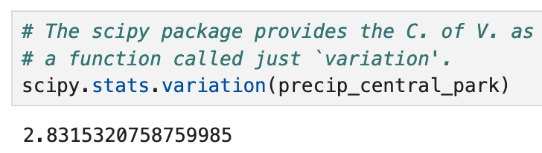
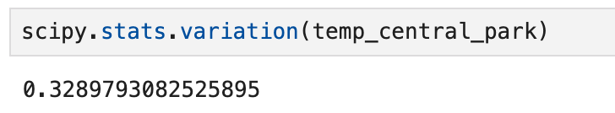
Coefficient of variation: the ratio of the standard deviation to the mean
Non-trick Q: based on the C.V., which is more variable!
A: Precip, by a lot! 2.83 / 0.33 ≈ 8.6 times larger!

Slide 45
What we’re covering today:
Measures of dispersion ✅
Measures of shape: skewness, kurtosis

Slide 46
Skewness: .

Slide 47
Skewness: how asymmetric are values about the mean value
Symbolically: we’ll come back to that once we’ve covered probability theory
Easiest to express in terms of expected values
Conceptually: do more values fall below (positive skew) or above (negative skew) the mean?
Q: What sign is the precip dataset’s skew?
A: positive!

Slide 48
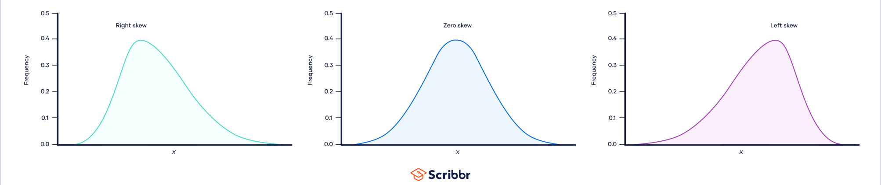
Skewness: how asymmetric are values about the mean value
Positive skew
Zero skew
Negative skew
Likelihood
https://www.scribbr.com/statistics/skewness/, https://www.scribbr.com/wp-content/uploads/2022/05/Skewness-of-a-distribution-Large.webp

Slide 49
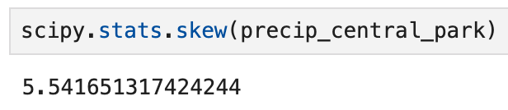
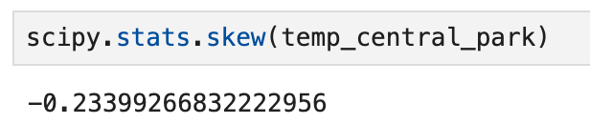
Skewness: how asymmetric are values about the mean value
By Diva Jain - https://codeburst.io/2-important-statistics-terms-you-need-to-know-in-data-science-skewness-and-kurtosis-388fef94eeaa,
CC BY-SA 4.0, https://commons.wikimedia.org/w/index.php?curid=84219892, https://en.wikipedia.org/wiki/Skewness

Slide 50
Kurtosis: .

Slide 51
Kurtosis: how “fat-tailed” a dataset is, combining both directions
Symbolically: we’ll come back to that once we’ve covered probability theory
Easiest to express in terms of expected values
Conceptually: are there lots of values far away from the mean in either direction (large kurtosis) or no (small kurtosis)

Slide 52
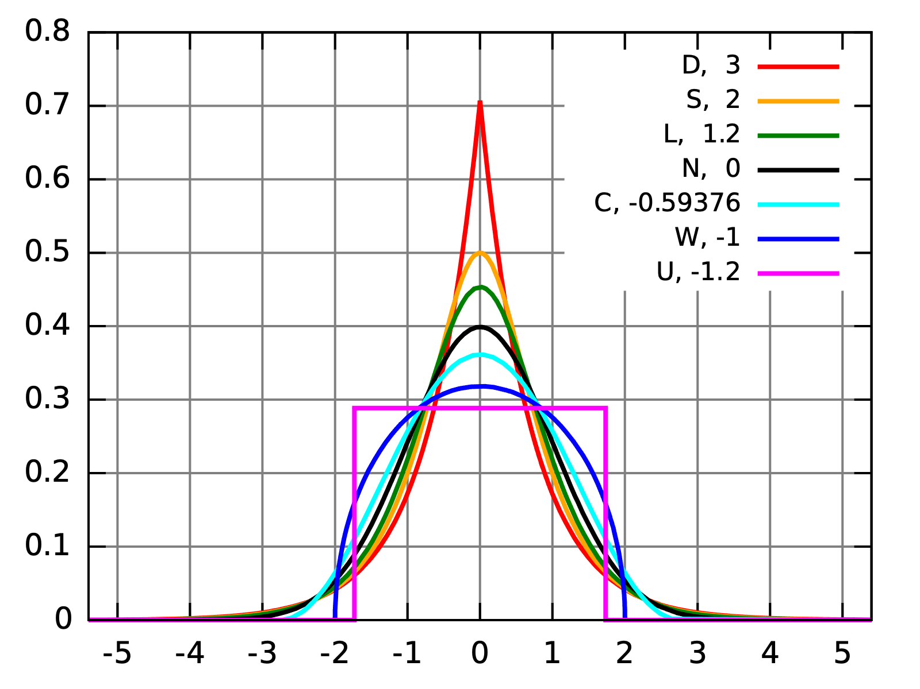
Kurtosis: how “fat-tailed” a dataset is, combining both directions
Distributions all with mean=0 and variance=1 but w/ different kurtosis
https://en.wikipedia.org/wiki/Kurtosis

Slide 53
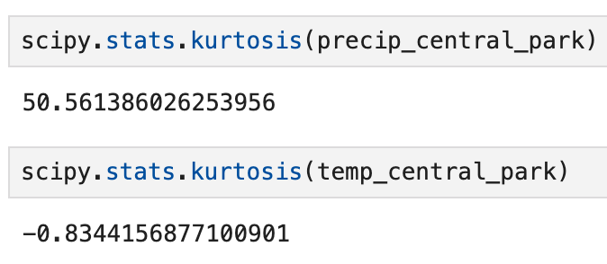
Kurtosis: how “fat-tailed” a dataset is, combining both directions
https://en.wikipedia.org/wiki/Kurtosis

